Slide 1

Tell us you’re moving
Show and Tell

Slide 2

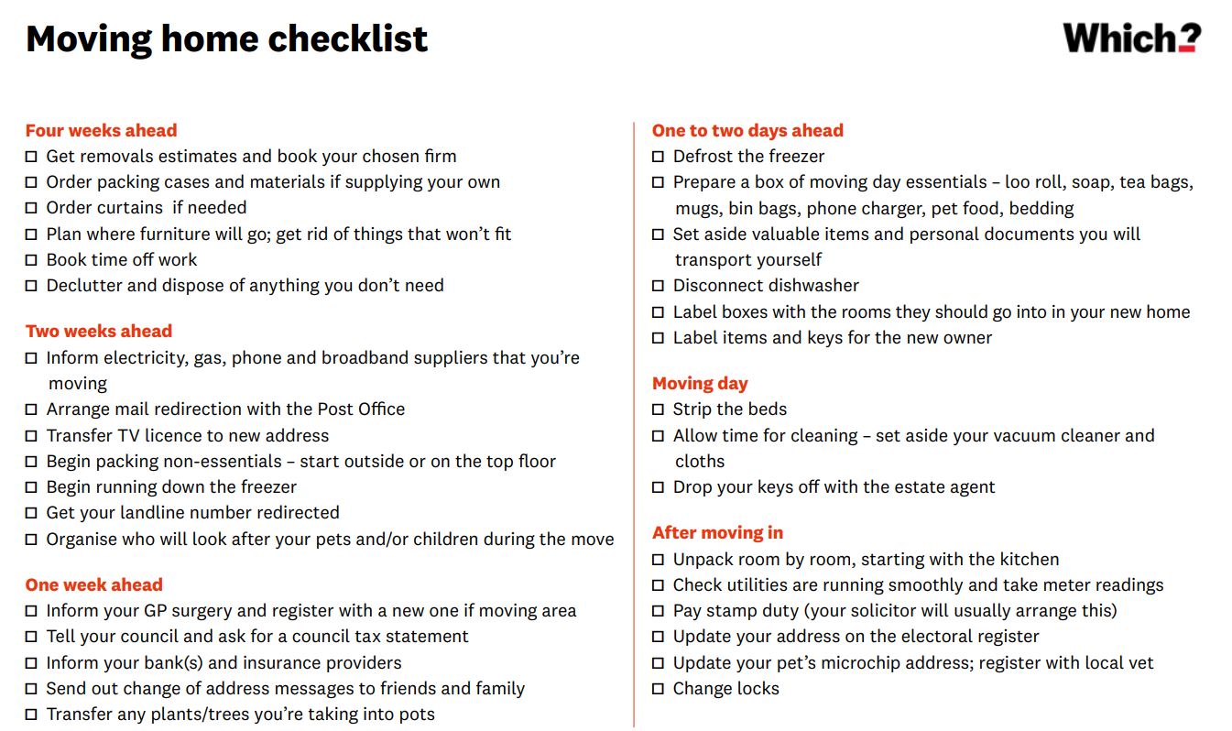
Moving home
Moving home can be a stressful experience for many people.
The Council is one organisation that most people must contact when they move home.
It is a legal obligation for most people to tell us they live in the borough to pay their council tax and register to vote.
Government bodies - Financial Institutions - Insurance providers - Utility suppliers - Regular bills - Health services - Work & education - Leisure & family activities
Notes:
Why have we looked at this?
Headings – multiple organisations under each of those
Make our bit better!

Slide 3







Why are we looking at this? 1
OUR HYPOTHESES
TESTING OUR HYPOTHESES
There is an opportunity to improve customer experience by the providing a ‘joined-up’ user centred service
What do we know about how customers are experience our services now?
CUSTOMER EXPERIENCE
Our service for people to tell us they are moving home could be made more cost effective through channel shift and automation
How much time is spent on processing moving home enquiries? And how much does this cost us? Why are customers using certain channels?
COST EFFICIENCIES
There is an opportunity to increase the accuracy of the personal data we hold.
To what extent do we have an issue with data accuracy between different databases?
DATA ACCURACY
Offering personalised information about their community and services would be valued by customers.
What information would new residents value when moving into a new community?
How would they like to receive this?
PERSONALISED
COMMUNICATIONS
Sharing data with other local public services would reduce the administrative burden on our residents
What expectations do customers have linked to the sharing of information with external services?
DATA SHARING

Slide 4





Project scope
Council tax moves in, out and within the borough for tenants and owners
Housing benefit and CTS change of circumstances
Waste services (incl. Garden waste subscriptions, clinical and assisted collections)
Electoral registration
Feasibility and viability assessment of new technology and integrations with back office software
VOTE

Slide 5




Project Activity
```
Who has been involved?
What have we spoken about?
Desktop Research
User Research
Customer Services – Russ, Mary & Cat
Council Tax – Cathrine, David, Karen & Karl
Benefits – Sam & Dawn
Waste – Ruth
PST – Phil & Lohitha
Current processes
Things that are working well
What is difficult or frustrating
Analysis of customer demand data – type and frequency of contact
Analysis of customer behaviour and journeys
Research approaches and practices of other local authorities
Their experience of the service they received
What is important to them
Awareness of paid for services
What expectations they have around external data sharing

Slide 6

Process findings
814 different phone numbers contacted us regarding a CT move

Slide 7

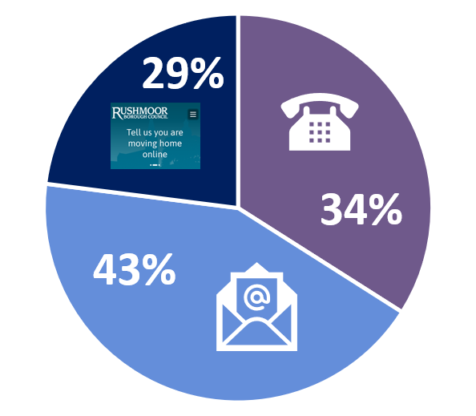
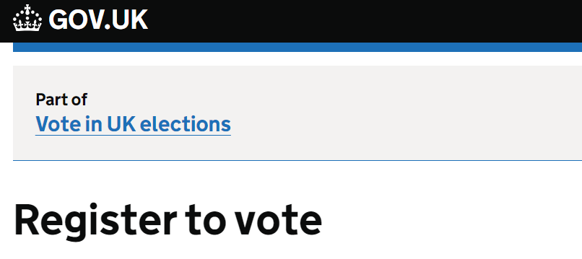
Customer demand
Average monthly customer demand
791
518
1,060
CT moving home interactions (within CS)
New occupier actions within
i-world*
Electoral Registrations
29%
Demand data does not align with customer moves
Council Tax Demand
Peaks in Electoral Registrations attributed to Council correspondence (Election/Canvass)
Majority of Electoral Registrations processed through the gov.uk site
Move
within
Move
In/out
1,033
5,643
Av. 14 mins per enquiry
Av. 12 mins per enquiry
Already
aware
1,383
587
Too early
Over £27k in CS time
Av. 4.5 mins per enquiry
Av. 5.5 mins per enquiry
* Duplicate accounts removed
Notes:
- Some areas in scope of the project have been harder to attribute customer demand to customers moving.
- This data shows the CS demand and the work added to CT system
- Explain the gap – why do we have more CS demand vs. CT system… already aware and too early data
- Access channels, interested to know why people aren’t using online so much as other services, residents have said in past that online hard to find on website which is why emailed/phoned, if a res has emailed in and not gave us all info we point them to the form.
- Elections – how this doesn’t align to move data – more linked to our contact with customers. Bit higher than expected, upward peaks down to canvassing

Slide 8

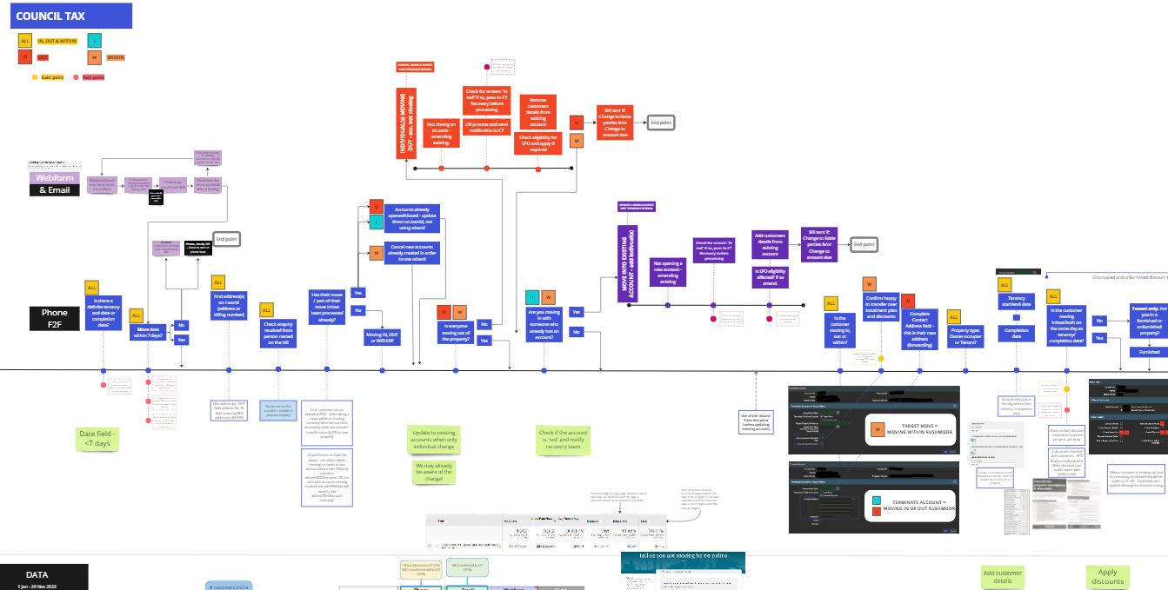
Council tax
process findings
Provided clarity on enquiry handling (‘red accounts’, move vs. tenancy/completion end date) and unoccupied/unfurnished requirements.
Push to focus on full customer journey – direct debit set up
Encourage the move to e-billing
Online processes are unable to apply the 7-day rule which results in workarounds, and potential processing errors.
Customer service staff need to remember and schedule specific actions, like handling red accounts, following up on bills for PCLC2, and removing inspections.
Customers who contact us through webform or email receive welcome messages with useful links, but there's no equivalent for those who call us.
Process for signing up for e-billing isn't straightforward and isn't promoted.
Integrating direct debit setup with current web form/email requests isn’t currently possible due to the required billing number.
North Lincolnshire Council: User Research Summary Report.pptx - Google Slides
Notes:
Mapping the process
identified different needs (whole household vs. individual moving etc).
Whats working well / not working well – what the system helps with and hinders
Have cross team meeting – navy blue points
Orange points
Link to research – North Lincolnshire – customers receive really good help when contacting but often don’t know what help is available before making contacting (disc. Eligibility and instalments)

Slide 9
Council tax process findings 1
Why do we have so much duplicate contact?
70% of ‘already aware’ contact arrives via email. With 60% of these emails coming from energy providers and tenant support websites.
These companies are often working on behalf of landlords/managing agent and often tell us after the moving in date.
Already
aware
1,383
Av. 4.5 mins per enquiry
It is inevitable, with multiple involved parties, that we will receive duplicate contact.
There is potential to improve the way third party companies interact with us.
Customers like to tell us in advance of their move out of RBC, especially tenants.
Most customers are notifying us within the 7-day limit.
£1,980 in processing time
When do customers tell us about their move?
(Webform Analysis)
Moving in more likely to tell us closer to their move date
Moving out more likely to tell us in advance
67% of “too early” web demand is from tenants
Too
early
587
Av. 5.5 mins per enquiry
£947 in processing time
Notes:
Make a decision with the 3rd party notifications, do we ignore then totally or ask them to use web form?
Lots of reasons for 7 day rule, one is moving dates change all the time so more efficient if we action 7 days before to avoid ‘redoing’

Slide 10
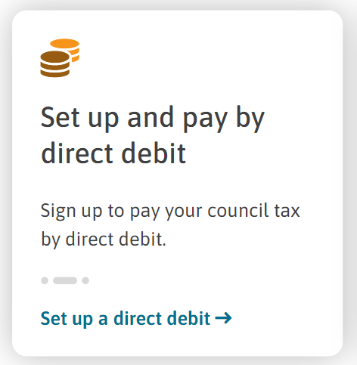
Council tax process findings 2
Direct Debit Analysis
83% of all CT accounts currently DD payers
vs.
Only 30% of sample cases
(moved between Sept-Nov 2023)
89% of Direct Debits are set up online
Customers value DD as a payment method with most customers setting DDs up online
Separate ‘move’ and ‘DD’ processes result in delay in setting up DD and additional cost in producing and sending bills.
60% of customer who moved to DD during 2023 had a change in liable party.
DD’s were set up around 28 days after their move was processed
747 move into RBC webforms
82% of customers wanted to pay by DD
£332 in print and post costs for additional bills
Royal Borough of Greenwich Findings - Google Drive
Notes:
- Lots of customer pay by DD and they set it up online – Residents automatically look to do this online
- When customers move in and tell us using the online form over 80% want to set up DD – separate process which prevents this (no billing number)
- Customers who moved to DD during 2023 most had a change to their liable parties – it took these accounts 28 days (median) to set up their DD. Residents will tend to want to see their bill before setting up DD.
- Impact on costs of bills/postage and also potential delayed collection.
Greenwich Research: Most customers happy to receive bills digitally. Online account not necessarily needed if setting up DD unlikely to use it.
Ebilling for us requires customer to set up council tax account.

Slide 11
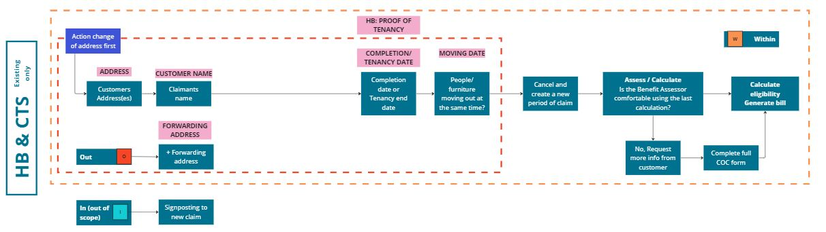
Benefits process findings
35% of demand is received directly from customers
19,490 notifications received into team during April – June 2023
9,131 new claims + COC during same period
Scope has been focussed on customers with existing claims – those moving within and out.
New claims – out of scope.
Team set up to respond to digital notifications
Consider the implication of any future work with CT on those accounts with CTS awarded
Opportunity to consider review of the CoC form

Slide 12
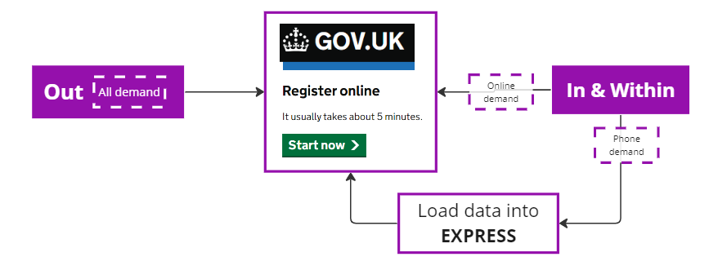
Electoral registration
Majority of demand enters via the GOV UK registration process
Direct registration demand increases following receipt of our correspondence (Canvass, Election etc)
CT weekly updates
Weekly report showing all properties with change to liable parties
At least 61% are sent ‘Encouragement letter’
£6,216 costs in time to process, print and postage
Customers often update their Electoral Registration after organising their Council Tax, rather than simultaneously.
Working hard to maintain ER accuracy through a combination of automated reporting and manual checks.
Different goals/eligiblity: CT liability vs. Eligible Electors
Signposting to Gov UK as an efficient registration platform
Customers unaware of data sharing between departments
Local data match (pre-canvass): 70% match with CT database
vs.
20% match of ‘sample’ cases
Move process Sept-Nov – reviewed for ER March.
Moving in/within: all registered after their move actioned ranging from 12 – 127 days after.
Moving out: all removed after their move actioned, ranging from 5-8 days after.
Notes:
Phone Sample – Movers between Sept – Nov
At point of reviewing (March) over 79% either not registered or registered elsewhere in RBC

Slide 13

Waste services –garden waste
Current demand
63 customers
“GW end bin contract”
86% digital take up for GW service
User satisfaction of at least 90%
Effective digital services in place already, integrating with these could enhance the customer experience.
Scope to improve work associated with moving within
Household vs. Individual subscriptions – how this affects existing and future processes
Manual processes in place by CS to update customer data (DD related) subject to errors and issues downstream
Lack of functionality to remove personal data from renewal processes results in previous occupants receiving renewals
Difficult to quantify this work in relation to change of addresses
3,707
“GW new bin subscription”
2,970 did not need a bin (late renewals – existing or new customers)
Manual work by CS to check status of address
(incl. open worksheets report)
‘Push service on’ if customer ready to go!
No online process for moving within → Outlook reminders to action moves within
Notes:
- We have effective digital services working well already for customer to join – link up to existing process to provide a more joined up service
- Gap in terms of how we manage people moving out and within
- requires some thinking around household vs. individual subscriptions and impact of moving to email invoices.
Check status of address: i.e. DD – checking not just whitespace but Integra to. Email address removal.

Slide 14
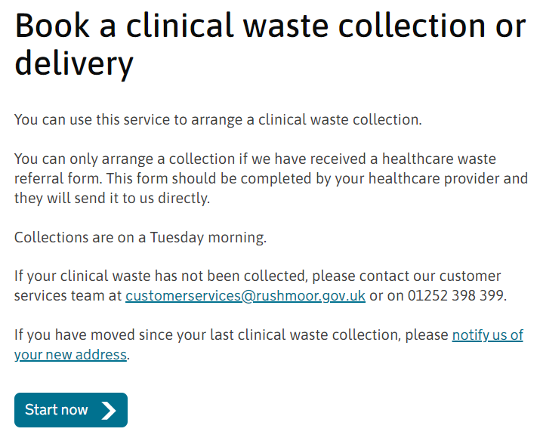
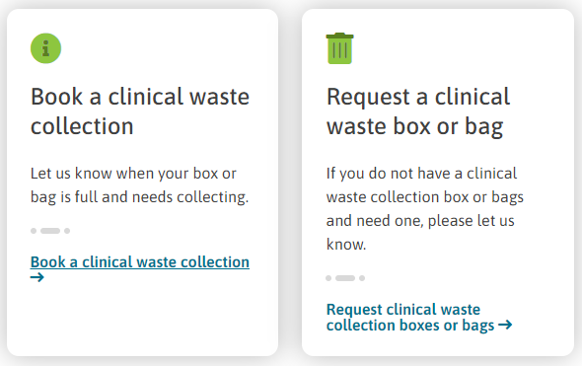
Waste services – clinical waste
Move in Signpost customer to obtain a Healthcare referral form, from their GP.
Forms are received into a special mailbox and customer database updated
Once customers are on the database there is no formal process for removal
Free collection of clinical waste once referred by healthcare professional.
Av. 10 new ‘sign ups’ per week
Approx. 2k Healthcare forms stored electronically in SharePoint
Move out/within No proactive process in place, customer driven.
Within: Online capability for customers to change their address – auto update to database.
Effective digital services already available for customers – steady increase in usage since go live.
Integrating with existing processes to improve customer experience.
Potential to improve data management of customer information – retention and accuracy but implementing a review process.
Ad hoc bookings only, customer requests as and when needed
Digital uptake of around 40%
Notes:
- Not a huge demand/ number of customers
- Customers have the ability to update their address on the website
- Issue is mostly around data management as we currently don’t have formal process for removal.

Slide 15
Waste services – assisted collections
Additional service for customers with mobility difficulties, and no support in the property or from neighbours.
Service is not actively promoted – discuss as an option when requested
Low need – 631 on the service currently
Cost to us: £10.97 per property, per year
Move in No proactive service, only upon request from customer.
Do not wish to publicise this service.
Move out/within No ‘ongoing’ process currently in place to remove/move the assisted collection (except for Tell us Once notifications)
Changes picked up when notified by customers or during review.
Latest review:
631 on the list
200 reviewed – 43 removed
Potential to improve data management of customer information – retention and accuracy
Remove spend on unnecessary assisted collections
20% of current users:
Over £1,500 each year
Notes:
- small customer base – not aware of doing a change of address for assisted collection!
- not something we want to promote as incur costs
- mindful of money being spent on customers who no longer need it
Have recently done a cleanse of addresses that are on assisted where the person who wanted has moved out

Slide 16
Customer behaviour
814 different phone numbers contacted us regarding a CT move

Slide 17



Customer behaviour 1
Sept – Nov 2023 phone demand
Feb – Dec 2023 email demand
814 different phone numbers contacted us regarding a CT move
918 different email addresses contacted us regarding a CT move
1,104 calls re: CT move
921 other calls
1,370 other emails
1,489 emails re: CT move
Av. 1.3 per #
Av. 2 per #
Av. 3 per @
Av. 1.6 per @
47 Bin orders
31 Bulky waste contacts
21 Garden waste enquiries
19 Electoral Registration
13 Clinical waste
5 Benefit enquiries
2 Assisted collection
3 waste enquiries
4 Benefit enquiries
*Already aware, other CT related enquiries, request more info)*
54% of customers contacted more than once
75% of customers contacted more than once
26% of emails
received from
5 companies (1,410)
(SSE, Good lord, I am moving, Tenant shop, help the move)

Slide 18
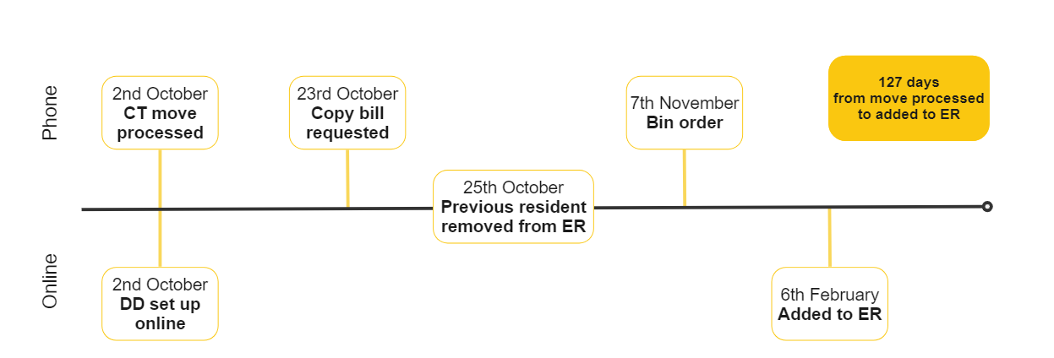
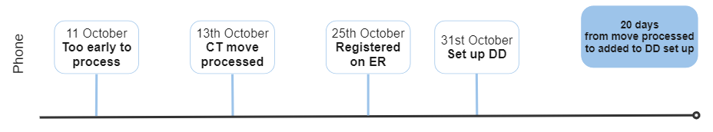
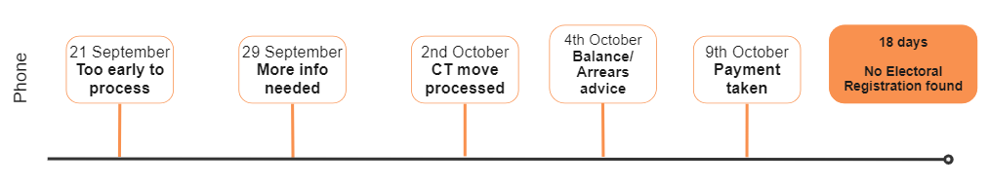
Customer behaviour 2
Customers are often contacting us multiple times to resolve matters arising from their move.
Many of the services that customers are contacting us about can be resolved by Customer Services or via a digital service
Customers tend to address council tax matters first, before other issues like Electoral Registration (ER) or bin orders.
Internal processes don’t always meet user needs – customers may be unknowingly removed from ER following CT weekly report and are required to re-register.

Slide 19
User research 1
Why they contacted us via their chosen channel?
What were they trying to get done when they made contact with us?
Levels of satisfaction with the service they received
Expectations related to other council services
What information they may like to receive upon moving?
Expectation around how their move is handled with external organisations
Awareness of paid for services
Any suggested changes to improve the service
10 one-to-one conversations held to gain qualitative insights related to:
Their experience of the service they received
What is important to them
Awareness of paid for services
What expectations they have around external data sharing
Surveys were also designed and rolled out however response rates were very low.
Move type:
Moving out of RBC – 5
Moving into RBC – 4
Moving within RBC - 1
Method of contact:
Webform - 5
Phone - 4
Email - 1

Slide 20

USER RESEARCH 2
```
Why they contacted us via their chosen channel?
Webforms
More convenient to me, can do it in my own time
Easier to do it online if it’s a straightforward process
Was online completing other move related matters
Phone
Quicker response, dealt with immediately
More clarity over the phone, with money related things it's important to speak
Went online first, was directed to contact via phone
Email
Tried to do it online but couldn’t
“I had a look around on the website but couldn’t work out where to do so I emailed”
“I would always choose to use the internet, its normal part of life now”
“[phone] gives me a quicker response… usually get an automated response and then get a reply 2-3 days later if you email”

Slide 21
User research 3
```
```
What were they trying to get done when they made contact with us?
Levels of satisfaction with the service they received
Due to the way recruitment was carried out, all 10 customers spoke about their council tax.
Customers had enquiries related to their account balance, payment methods and potential discounts.
3 customers were also aware of their requirement to update their Electoral Registration.
Immediate acknowledgement, quick reply and reassuring service
Didn't take long to use the online form, was quick and easy
Found both the CT and ER links on the website, could do both at the same time
Very clear communications
Online account didn’t show my move so felt the need to check
Chasing response for email/bill
“…he was very very supportive; he gave me all the information… options… he was very helpful”

Slide 22
User research 4
```
```
```
Expectations related to other council services
Awareness of paid for services
Expectation around how their move is handled with external organisations
Customers often seemed confused by this question, with many not knowing which other services they needed to notify.
The most mentioned services were Electoral Registration and garden waste, but customers didn't expect the information to be shared; they saw it as their own responsibility to handle.
Customers had varying levels of awareness regarding Council-paid services.
Some were already signed up, some knew and weren't interested, and only a few were unaware of the options available.
Customers didn't expect the council to assist them with external organisations during their move.
Many recognised their own responsibilities in getting things done, though they sometimes suggested that helpful reminders would be useful.
However, some thought it would be appropriate for the council to support more vulnerable customers to ensure they were taken care of.
Hackey Council: (PUBLIC) Analytics, survey results and insight summary.pdf - Google Drive
“Pretty much all councils offer the same thing, so I think most people are aware of these types of services”
“Nothing more that I’m aware of that needs your attention – no more need to contact the council” [now CT has been sorted]
Notes:
(PUBLIC) Analytics, survey results and insight summary.pdf - Google Drive
Research by Hackney – customers contacting multiple sources re: their move wasn’t a problem for the majority to users

Slide 23
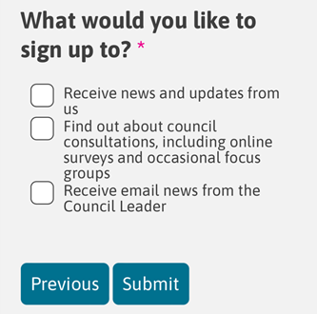
USER RESEARCH 5
```
What information they may like to receive upon moving?
Some customers did not feel they needed to receive anything directly, they were happy to find information they require as and when needed – referring to websites being informative ‘these days’
Bins, local tip and recycling information
Helpful reminders/ checklist of moving home actions
‘Information about my local area’ – customers were often vague about what this meant for them.
Some more niche requests linked to energy providers and support with finding the cheapest deals in the area, community safety matters and providing a welcome to the borough to enabling convenient parking on moving day.
Often customers were drawn to existing communications, receiving a paper bill – and suggested paper leaflets would be helpful. When asked about alternative methods, many felt email would be acceptable.
17% of webform users signed up for news
Majority sign up to receive news and updates
Around 50% sign up consultation and Leader news

Slide 24

UR findings
814 different phone numbers contacted us regarding a CT move
Customers are generally happy with the service they are receiving – potential to improve web experience by considering site navigation and service design of form
Customers are primarily focused on managing their Council Tax matters but many interact with us about other matters
Customers don't always know how the council works or what other services they need to inform when they move. We could help customers more proactively with ‘helpful reminders’
Most customers are aware of our paid for services, noting that ‘many councils offer the same things’
In relation to sharing information with external organisations, customers did not feel it's the Councils responsibility to help manage their move
Varied preference related to personalised communication and how they’d like to receive this information

Slide 25
Overall findings
814 different phone numbers contacted us regarding a CT move

Slide 26
Why are we looking at this? 2
OUR HYPOTHESES
HIGH LEVEL FINDINGS
There is an opportunity to improve customer experience by the providing a ‘joined-up’ user centred service
Customers are mostly happy with the service. They appreciate helpful customer service staff, and we have high uptake and satisfaction on many digital services. But they would value services being more connected.
CUSTOMER EXPERIENCE
Our service for people to tell us they are moving home could be made more cost effective through channel shift and automation
Potential to improve the web offering in terms of site navigation and service design which could increase uptake.
Further work is needed to determine if it's possible and worthwhile to automate work, initially considering CT work.
COST EFFICIENCIES
Staff are working hard to ensure data accuracy across systems – this is dependent on customer input and is not managed at the point of transaction.
Opportunities to improve data management relating to our waste services.
There is an opportunity to increase the accuracy of the personal data we hold.
DATA ACCURACY
Offering personalised information about their community and services would be valued by customers.
Customers have different preferences. Some say they can find everything online themselves, others want recycling info, and some need safety or parking updates. They also differ on how they want to get this info: some prefer email, others like letters.
PERSONALISED
COMMUNICATIONS
Sharing data with other local public services would reduce the administrative burden on our residents
Most customers did not expect the Council to be involved in information sharing with external organisations. Many felt it was their responsibility and not the Councils.
But they thought signposting would be helpful.
DATA SHARING

Slide 27
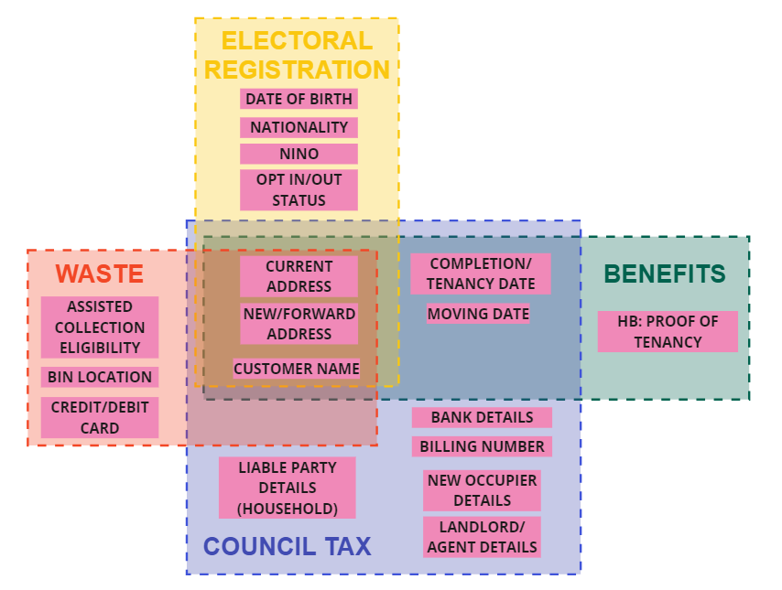
Integrated service
Although customer satisfaction doesn't indicate a need for a specific "tell us you're moving" service, there's potential and evidence to show that a more integrated service would be beneficial for both customers and us.
Benefits for customers
Improved handling of broader Council Tax related matters
Consistency in customers electoral registration
Efficient handling of waste related enquiries
Benefits for us
Cost efficiencies in automation of Council Tax demand
Improved Electoral register accuracy
Improved data management (ER & CT data sharing, waste services retention)

Slide 28

Next steps
Prioritise improving efficiencies in how we handle Council Tax related demand:
Work through our assumptions related to things that may prevent automation
Improve site navigation and form design – monitor digital uptake
CS to continue to join up CT related matters when handling phone contact – monitor impact on DD set up and e-billing
Services to consider and determine if action required related to customer data handling:
Council Tax privacy notice – consider sharing more explicitly with customers how their data is shared with Elections and the impact on their registration
Waste Healthcare referral forms – consider immediate and future needs to resolve retention concerns.
Future phases will consider how to progress other findings related to Electoral Registration, Benefits and Waste services.
814 different phone numbers contacted us regarding a CT move

