Slide 1




Show & Tell # 1
Taxi Licensing Alpha
1st August 2023
This project has been funded by the DLUHC Local Digital Fund

Slide 2

Agenda
Background
Meet the team
Sprint Zero - The Kick off
Delivery plan
Next Steps
Q&A

Slide 3
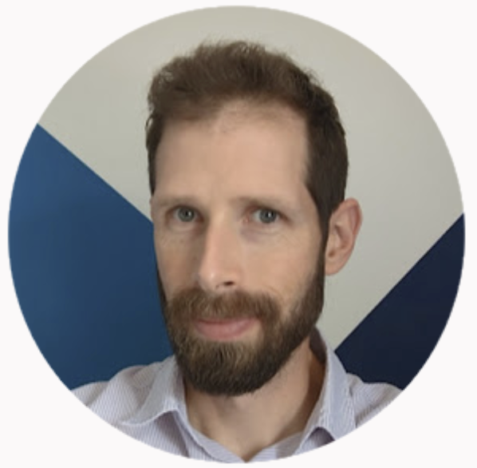

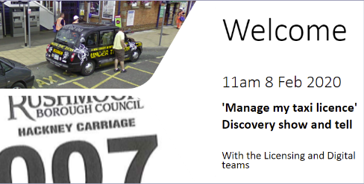
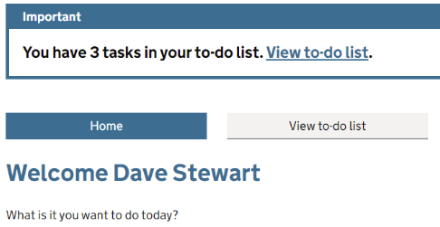

Background - The Why?
Alpha: exploring and prototyping a digital service for taxi licence holders to manage their licenses
Rushmoor Taxi Licensing Services Discovery in 2019/20
Rushmoor Taxi Licensing Alpha and prototype in 2020
Local Digital alpha funding bid 2021/22
…leading collaboration with…

Slide 4
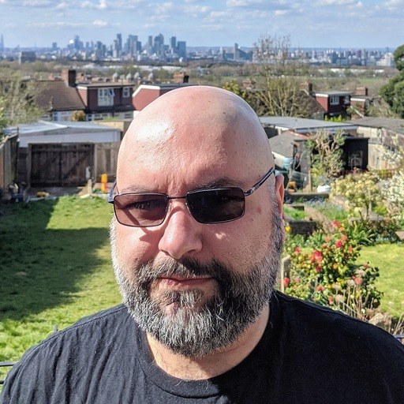

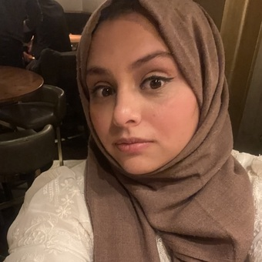
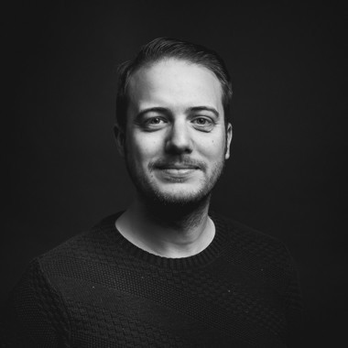
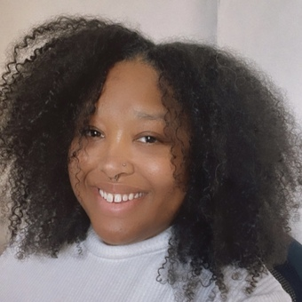

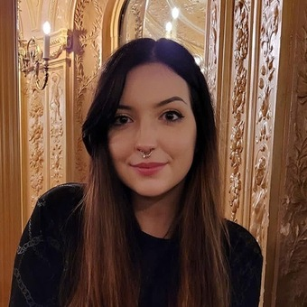

Meet the team
Seyed Razavi-
Nematollahi
Lead Solutions
Architect
Olga Kramarenko
Agile Delivery Manager
Areeba Siddiqui
Product Manager
Alex Stone
Business Analyst/Service Designer
Craig Eldridge
Software Developer
Verity Nelson
Senior Content Designer
Bradley Reeder
Senior User Researcher
Ash Middleton
User Researcher (Lead User Experience Designer)

Slide 5

Sprint Zero -
The Kick Off

Slide 6
The How?
  Problem Space Workshop
    Deriving the Problem Statement
    Alpha Goals
  Stakeholder Workshop
    Stakeholder Analysis
    Stakeholder Engagement Plan
  User Research Workshops
    Understanding the project focus

Slide 7
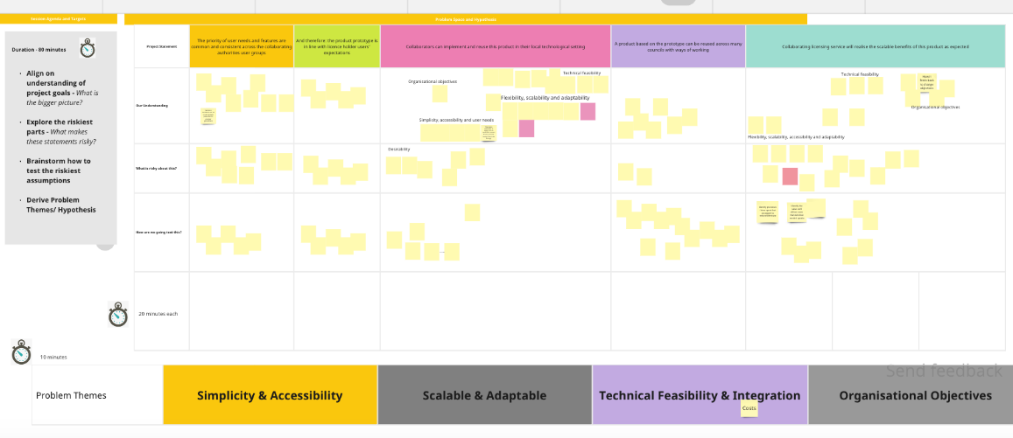
  What?
    Exploring the original hypothesis set out in the statement of work
    Problem Theming
Problem Space Workshop

Slide 8
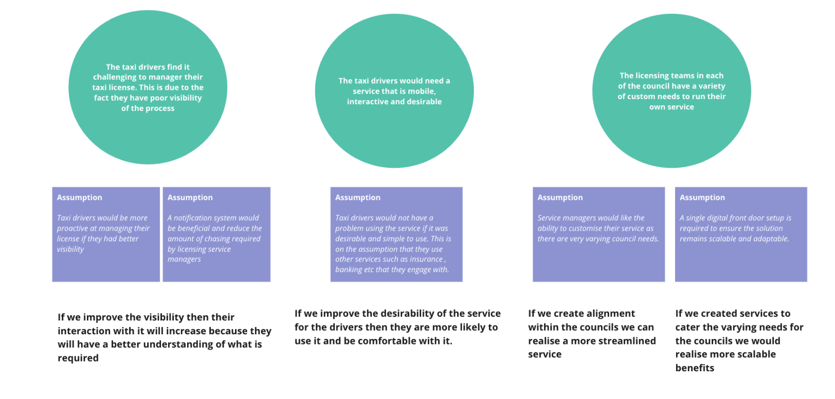
  Output
    Hybrid workshop across councils to understand the problem
    Derivation of hypothesis to test in the course of the project.
    Cross Council Alignment
    Problem Statement
We believe that digitising the taxi "Manage my licence" service will improve outcomes by simplifying the service. It will create a sense of ownership for licence holders and streamline the business process.
Problem Space Workshop

Slide 9
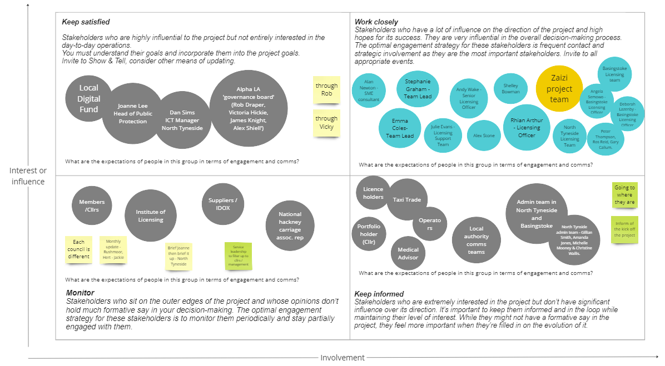
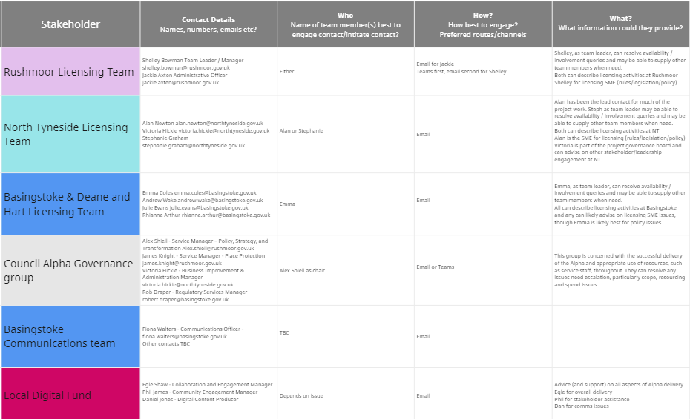
  What?
    Understanding the various stakeholders and their roles
  Output
    Stakeholder Matrix
    Engagement Strategy plan
Stakeholder Workshop

Slide 10
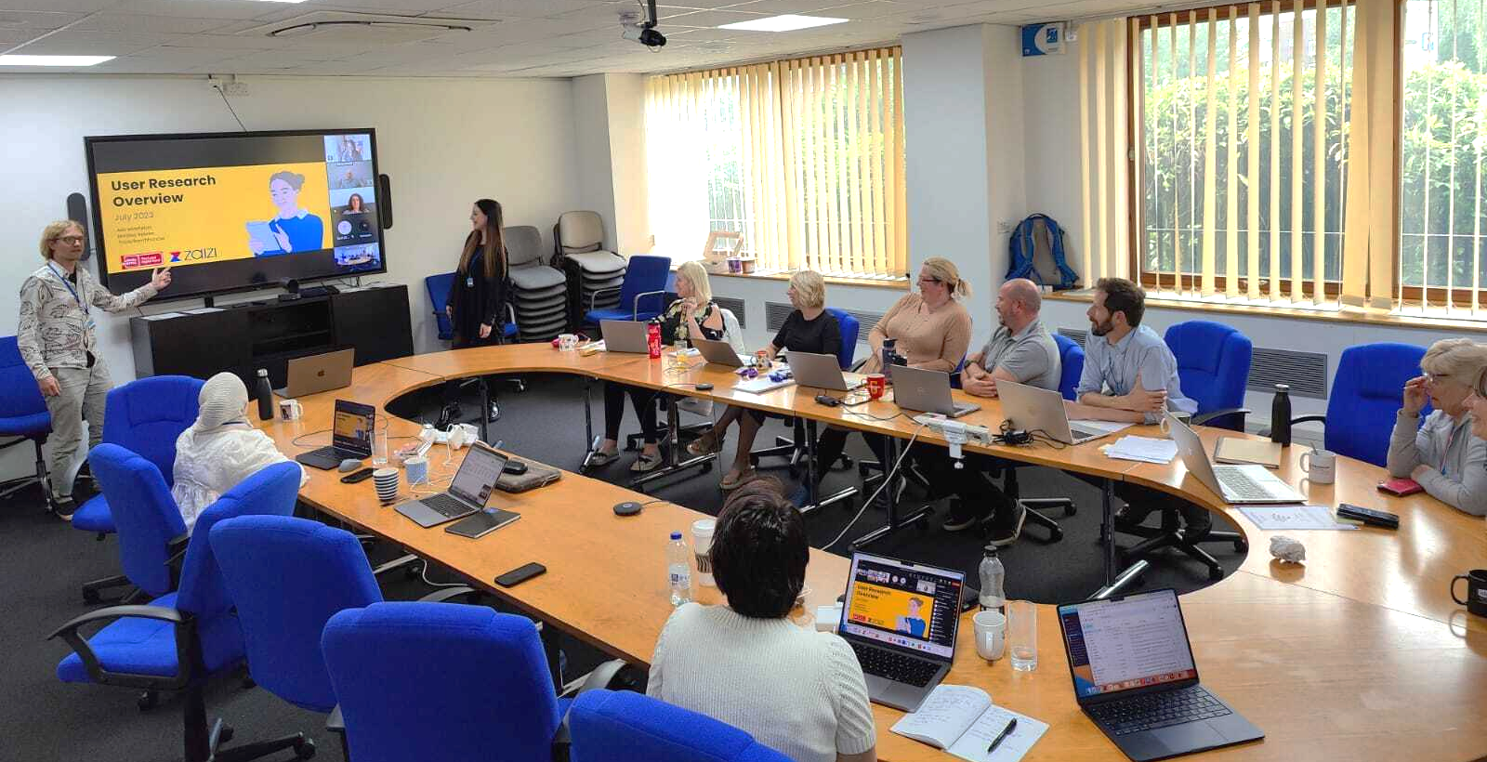
Meeting the councils
Notes:
Bradley

Slide 11

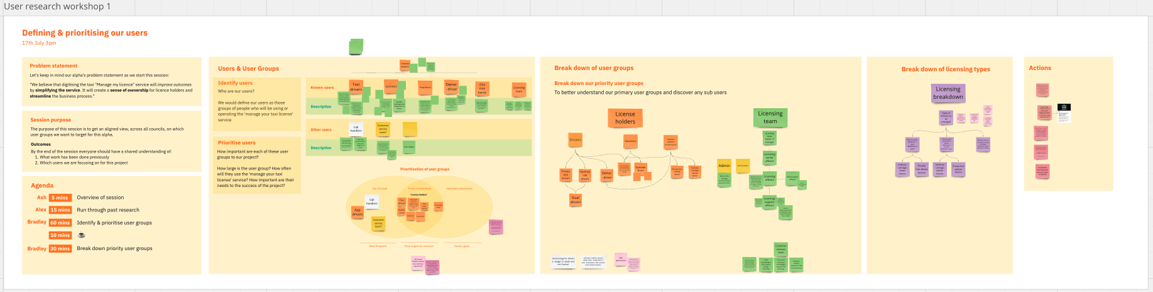

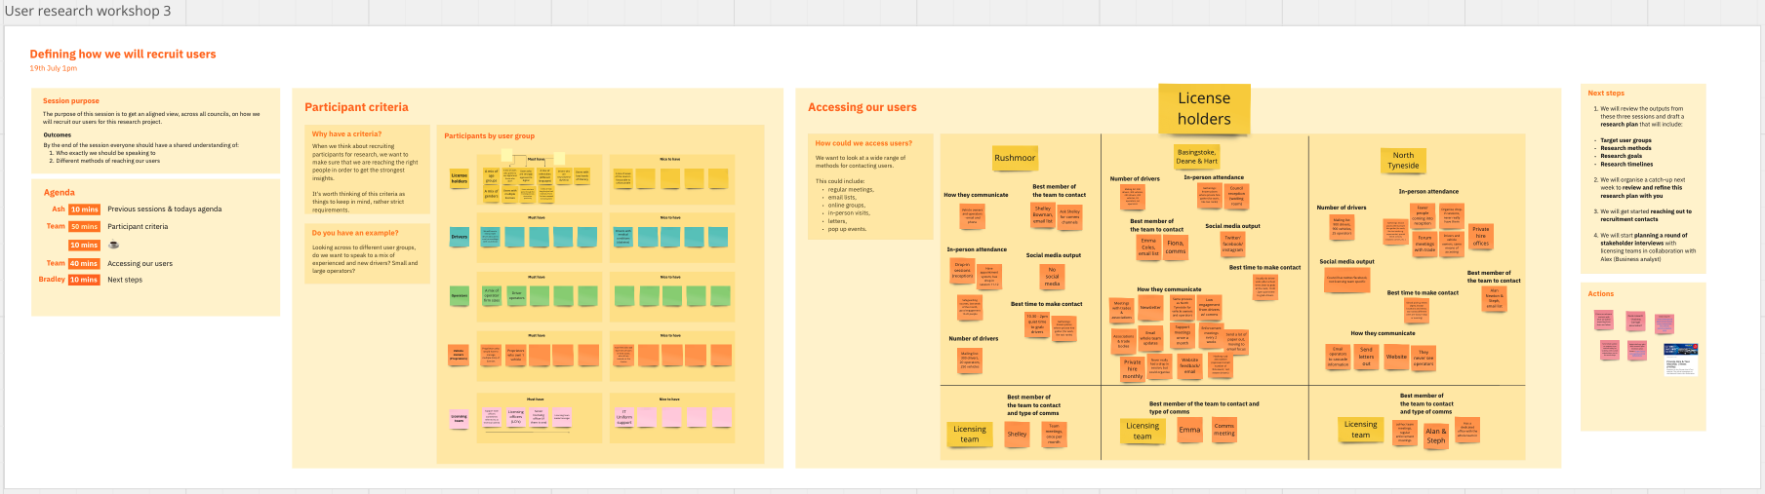
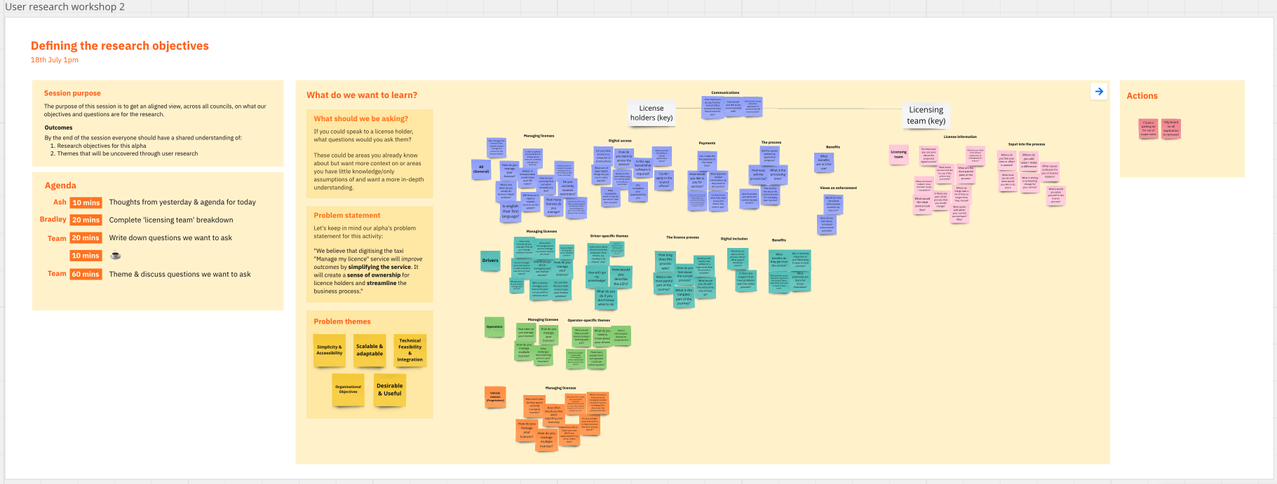


  What?
    Defining and prioritising users
    Research Objectives
    Question Themes
  Output
    Summarising Project Focus
    User Group Priority
    UR Recruitment Discussion
    UR Plan
User Research Workshops
We held 3 2-hour workshops
1. We defined the users
2. Detailed each council’s licence holder relationship and ways of working
3. Defined our research objectives

Slide 12
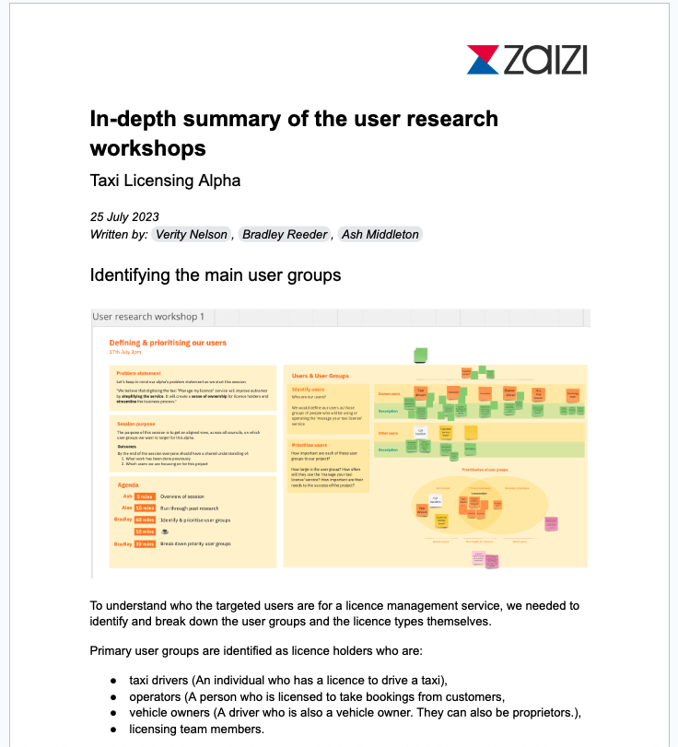

Summarising the project focus
Title
After 3 extremely useful meetings with all councils, we got to work summarising all the findings into one report.
It explains in full detail:
The best user groups for this project for us to focus on: licensing teams and licence holders,
The different licence types,
Each council’s research objectives and what they need,
The participant criteria and how to access and speak to their desired groups.
Notes:
Verity

Slide 13
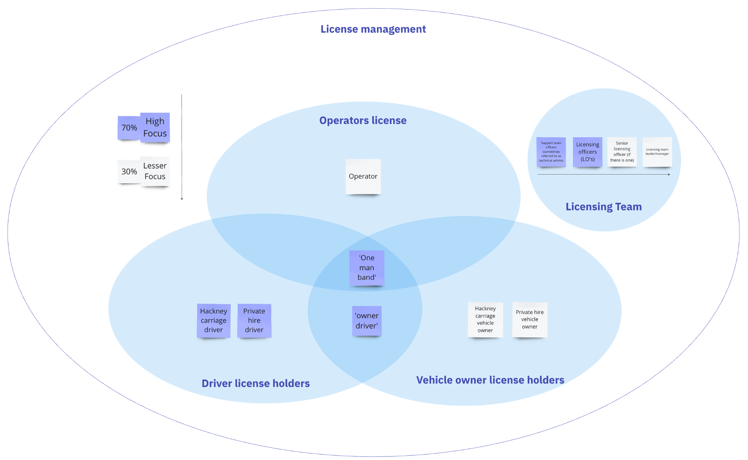
User Group Priority
Title
We then zoomed in on our users, defining together what focus we wanted to each group.
License holders
Drivers (high focus)
- Hackney Carriage
- Private Hire
Operators (lower focus)
Proprietors (lower focus)
- Hackney Carriage
- Private Hire
Notes:
Ash

Slide 14
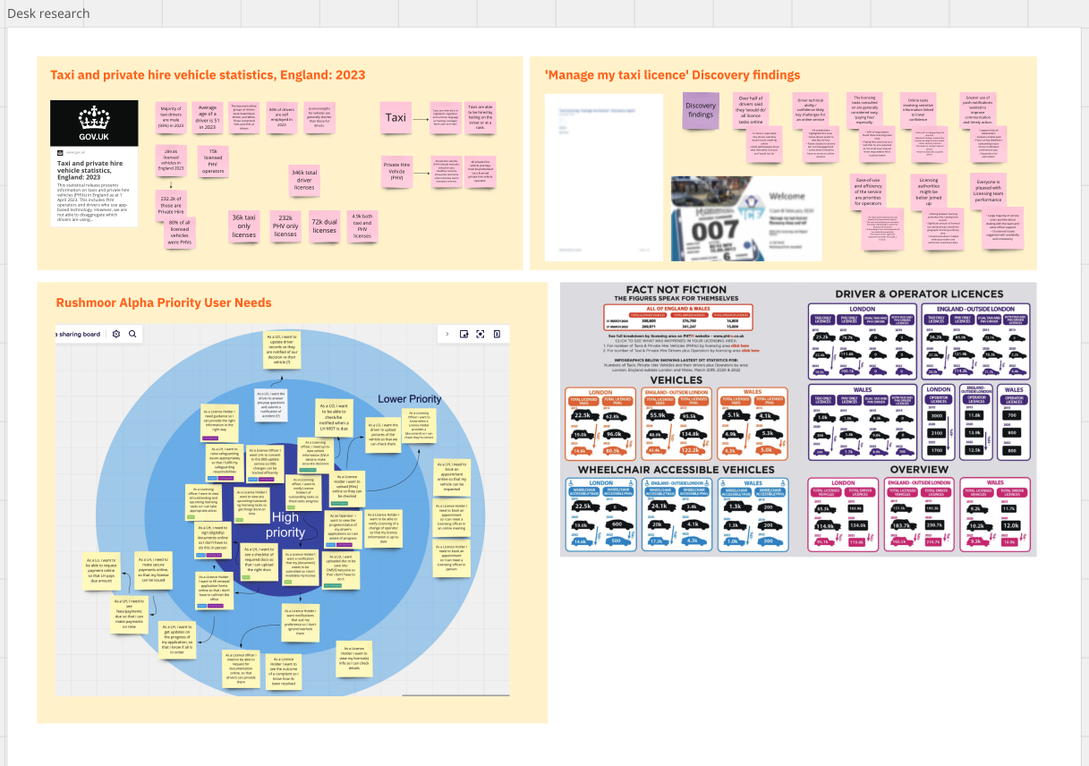

Understanding the background
Title
We also conducted desk research, to understand:
Latest industry reports
Vehicle & driver statistics
Review of previous discovery & alpha findings.
Notes:
Ash

Slide 15
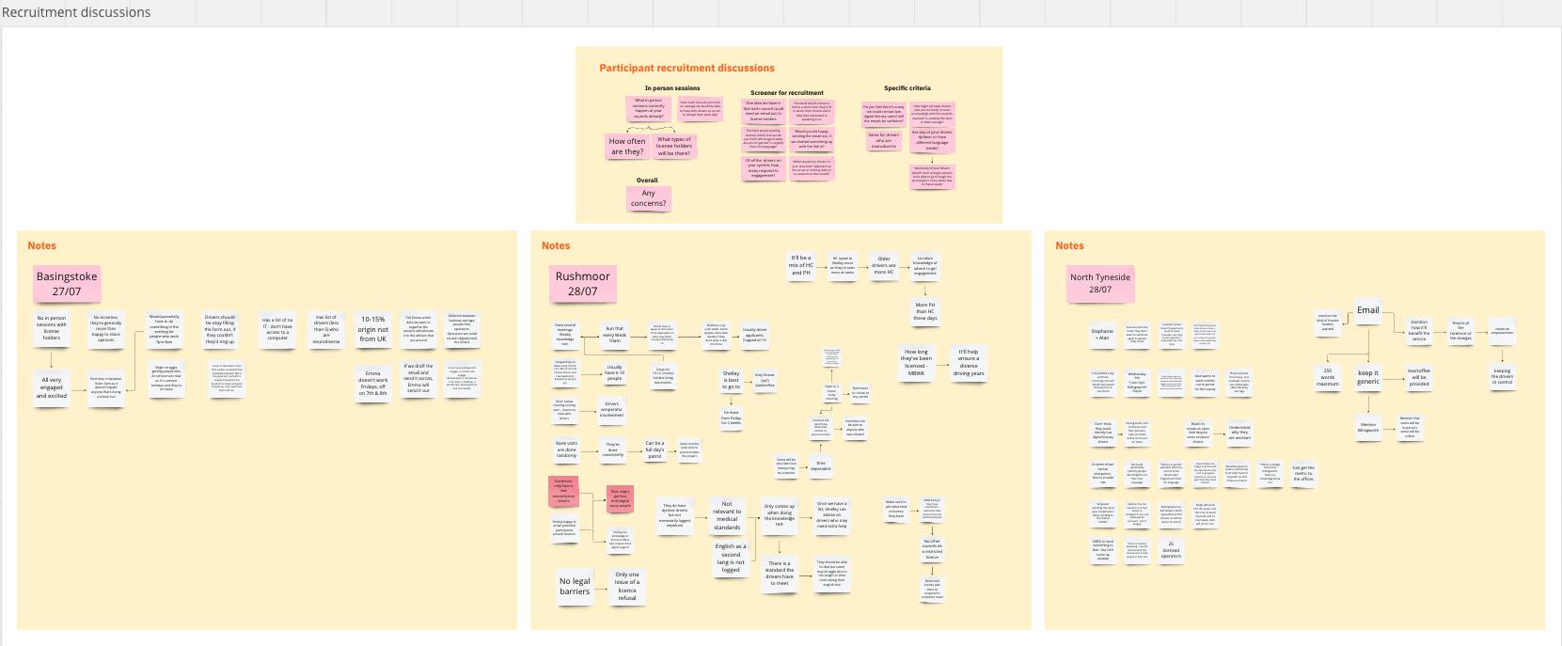

User recruitment discussions
Title
We also held hour long interviews with each council to understand:
How to recruit licence holders,
Driver-specific information and access.

Slide 16
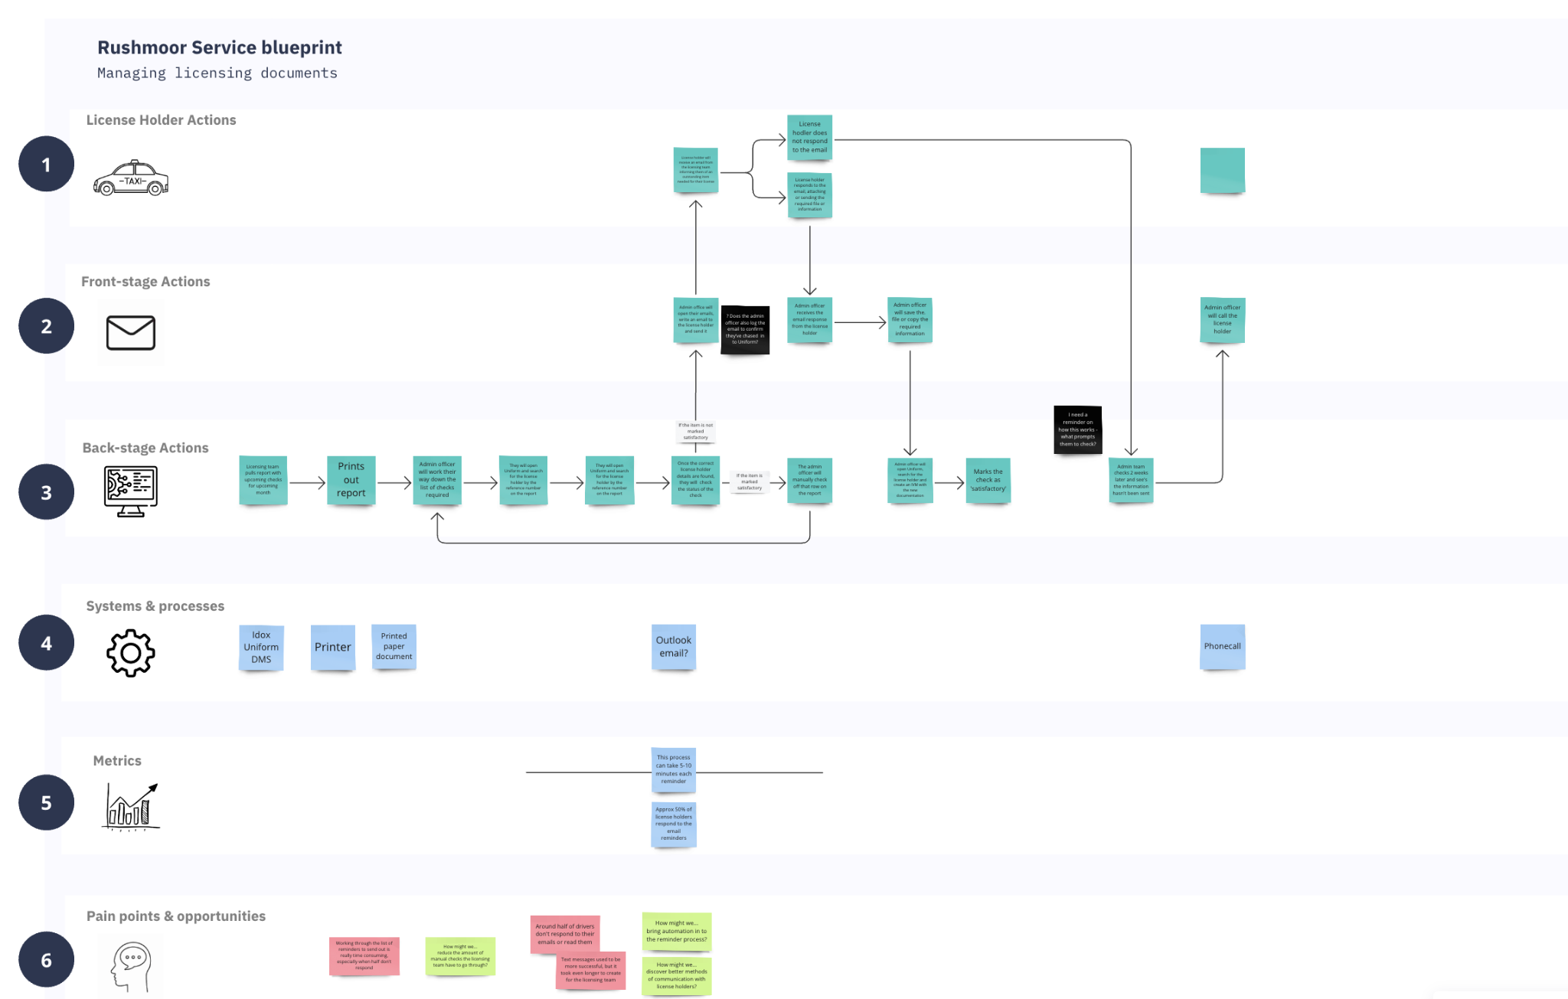
Stakeholder Interviews
Title
We have been conducting as-is process mapping sessions with each council, interviewing their licensing teams.
These sessions are informing the creation of service blueprints, which we’re using to understand opportunities and pain points in the current process.
Early findings are showing that a lot of the pain points are around the constant need to chase license holders.
Each council also has slightly different way of communicating with license holders, including variations in the sending of reminders.
Notes:
Ash

Slide 17
Research Approach
Council stakeholder interviews
We will speak to the licensing teams in each of the councils to discover their current experience of managing licences
We will go and meet licence holders across the different councils, to understand their needs and initial thoughts on the existing prototype
Round 1 - User interviews & concept testing
Research analysis & amends to prototype
We will analyse all the data we gathered when speak to licence holders, forming it into amends for the prototype
We will conduct 1-2-1 research sessions with licence holders across all councils, testing the usability of the prototype
Round 2 - Usability testing
Final analysis & recommendations
We will conduct a final analysis of the data, producing research findings and further considerations
Notes:
Bradley

Slide 18
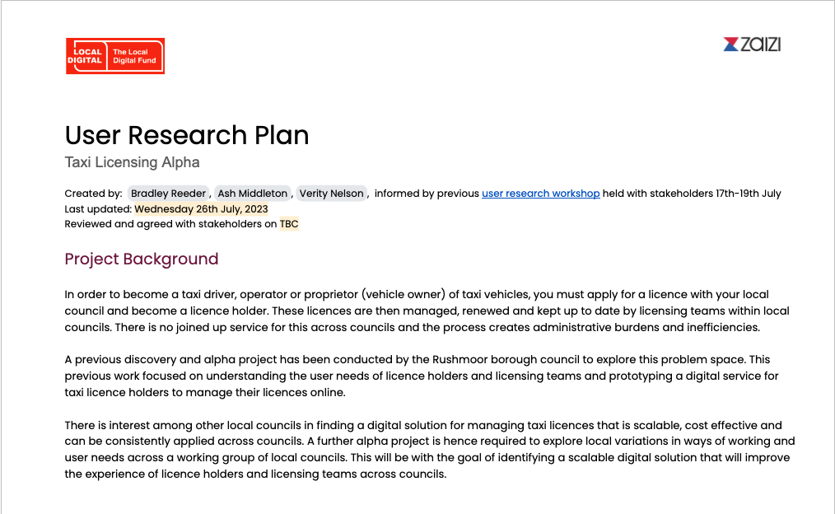


Research Plan
Title
Notes:
Bradley

Slide 19
What we’re planning next
1
Send out the recruitment email, via councils, with a link to the screener for completion by licence holders
2
We will draft a discussion guide, with the questions we’ll be asking licence holders, and share with the councils for review
3
Contact chosen participants & arrange in person research at each of the 3 councils, over the next few weeks

Slide 20

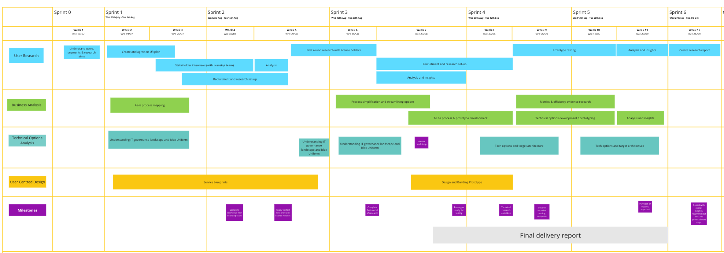
Delivery plan
We’re here

Slide 21
Next steps
Key dates for your diary
Show&Tell #2 : Tuesday 15 August 1-2pm
Show&Tell #3 : Tuesday 29 August 1-2pm
Show&Tell #4 : Tuesday 12 September 1-2pm
Final Show&Tell #5 : Tuesday 3 October 1-2pm
Starting Sprint 2 (Wed 2nd Aug - Tue 15th Aug) with the focus on:
Completing & summarising interviews with the licensing team
Completing recruitment and starting research with the licence holders
Completing as-is service blueprints

Slide 22

Thank you!
Q&A
How do you feel about work we reviewed today?
What excites you the most?
What is the one thing you would like to change?
How can we improve future Show&Tells?

